Slide 1

Harper Adams Specialist Maths Support tutor
Dr Simon Burrows

Slide 2
Academic Guidance Team
I am part of the Academic Guidance Team based in Edgmond…
… but I am employed to focus purely on the mathematical side of things.
The Academic Guidance Team helps students develop essential study skills through:
One-to-one appointments (in person or via TEAMS)
Workshops, drop-in sessions and contributing to teaching / tutor sessions
Provision of online resources
The team supports students in a wide range of areas including time management, academic writing, note-taking, correct use of AI, understanding assignment guidelines, exam technique and so on.

Slide 3


My background
Maths degree at University of York (1st)
Doctor of Philosophy (also York) [Electronics Dept]
About 5 years of actuarial work (pensions consultancy)
25 years as a maths teacher, 2nd in dept, and then HoD at Haberdashers’ Adams GS (in Newport, Shropshire)
At Harper Adams University since Autumn 2022 ☺
Notes:
At some points, my working life has been more interesting than at others… (currently good!)

Slide 4



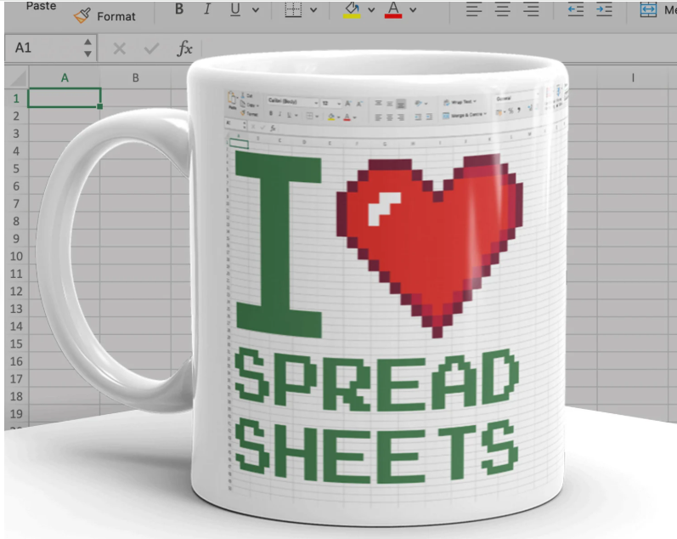
Simon is happy to help with:
Maths
Data analysis
Excel
Notes:
The ❤️ is an exaggeration! 😂
{Though, it is probably correct to say I do seem to enjoy playing detective and finding out how to do new things on Excel}

Slide 5




The best support I give tends to come when students have given me a bit of time to think…
I am one of the people who can support you should this happen…
I always try to tailor my help to your needs 👍
We can meet 1-1 or in a group (in person or via Teams)
Some things can even be resolved via email ☺
I also provide support materials on the VLE/LH, including “how-to” videos

Slide 6

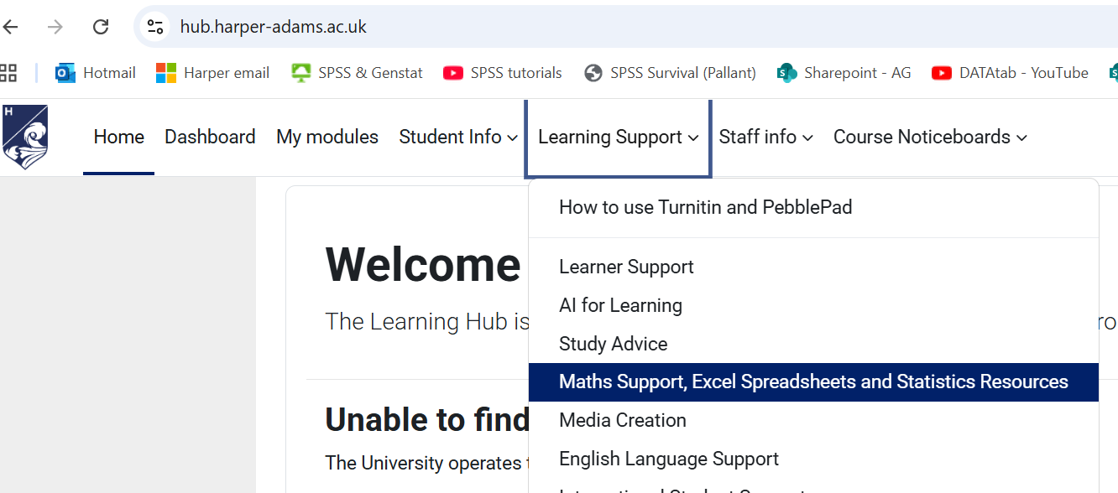
The “Learning Hub” or “VLE”
Notes:
Take a quick tour of the maths section of the Hub/VLE – students can try, too, if they like… (show the booking link and a selection of other Excel–related resources)

Slide 7
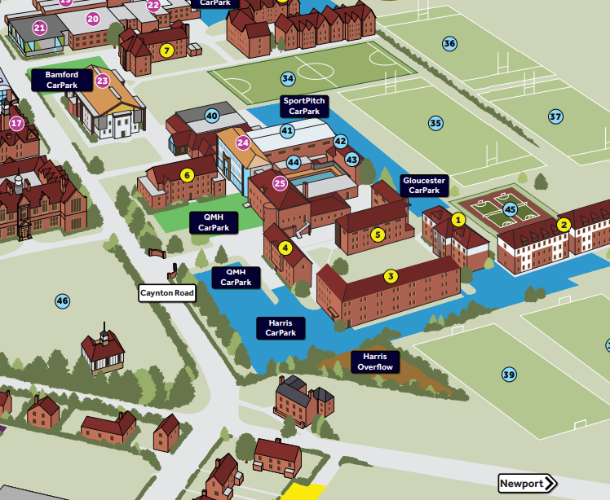

I am based at the Edgmond site {Faccenda Building, FS6, No 24 on the campus map}
I am available Tuesdays & Thursdays 9am-5pm {Term-time only}
Please do book online
or email: sburrows@harper-adams.ac.uk
or send a message via TEAMS
Notes:
Students could try the QR code, or take a photo for possible later use

Slide 8
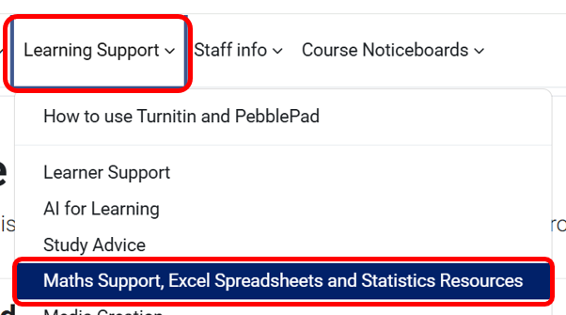
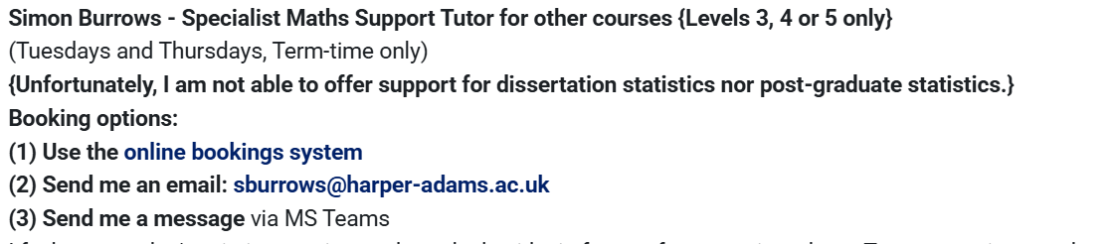
You can also book via the maths support section on the Hub
https://hub.harper-adams.ac.uk/
Notes:
I should have shown this when we visited the Hub in slide 5 above, but it is here as a reminder for me (if necessary)… and any student looking back at the powerpoint

Slide 9
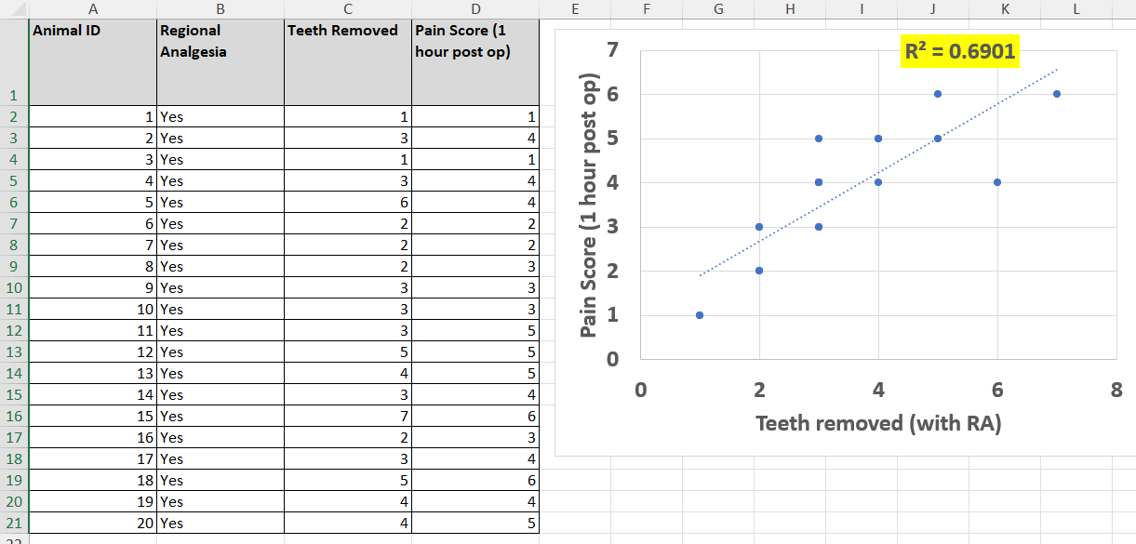
A few examples of student support work relating to Excel (1)
Scatter graphs
Notes:
Scatter graphs, lines of best fit, R squared = coefficient of determination

Slide 10
A few examples of student support work relating to Excel (2)
Pivot tables
Notes:
Creation and use of pivot tables (often used in association with a chi-squared test)

Slide 11
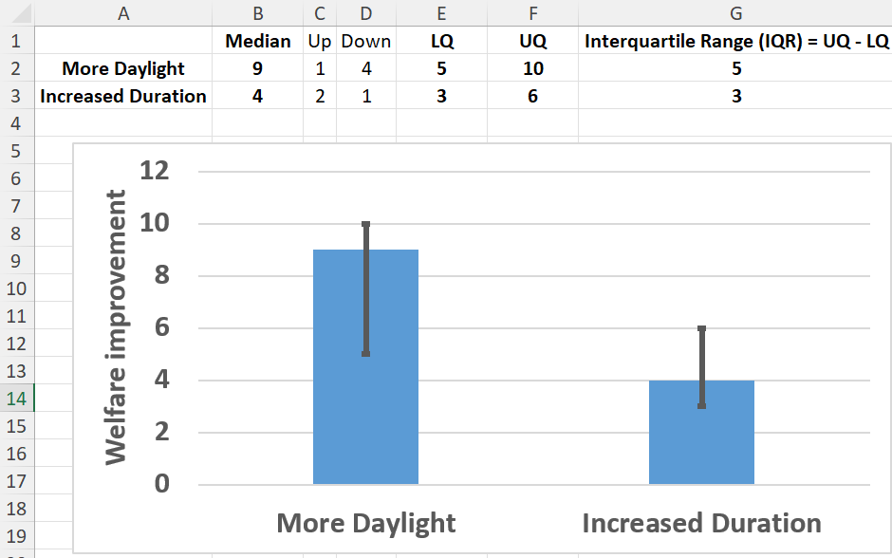
A few examples of student support work relating to Excel (3)
Bar chart with error bars showing the quartiles
Notes:
Whiskers/error bars are in common usage…

Slide 12
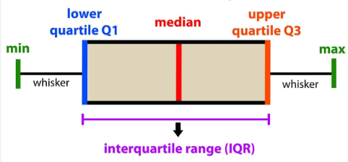
A few examples of student support work relating to Excel (4)
Another good graph to summarise the median and Interquartile Range (IQR) is a box and whisker plot.
LQ
UQ
Lecturers have different preferences…
Notes:
When presenting data, get to know what your lecturers prefer ☺

Slide 13
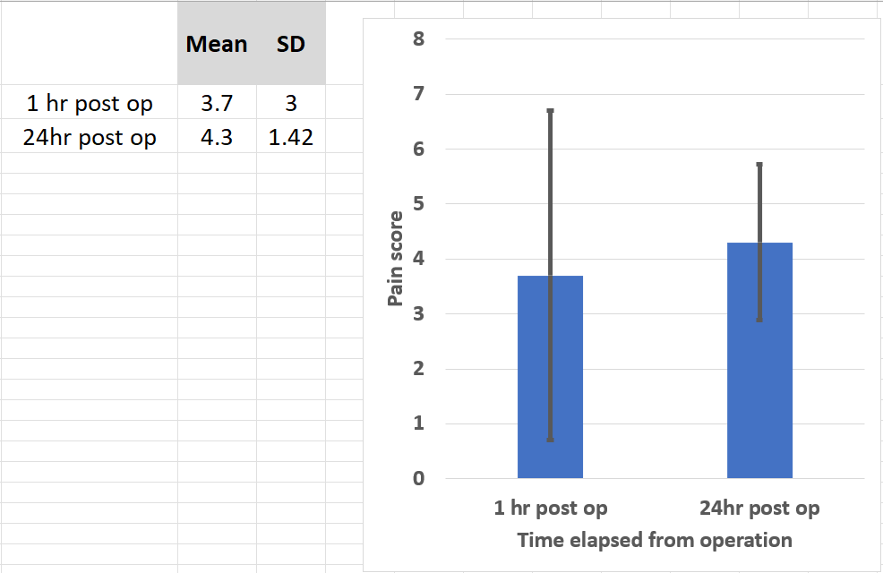
A few examples of student support work relating to Excel (5)
Bar charts + Standard Deviation for the error bars
Notes:
SD = Standard Deviation

Slide 14
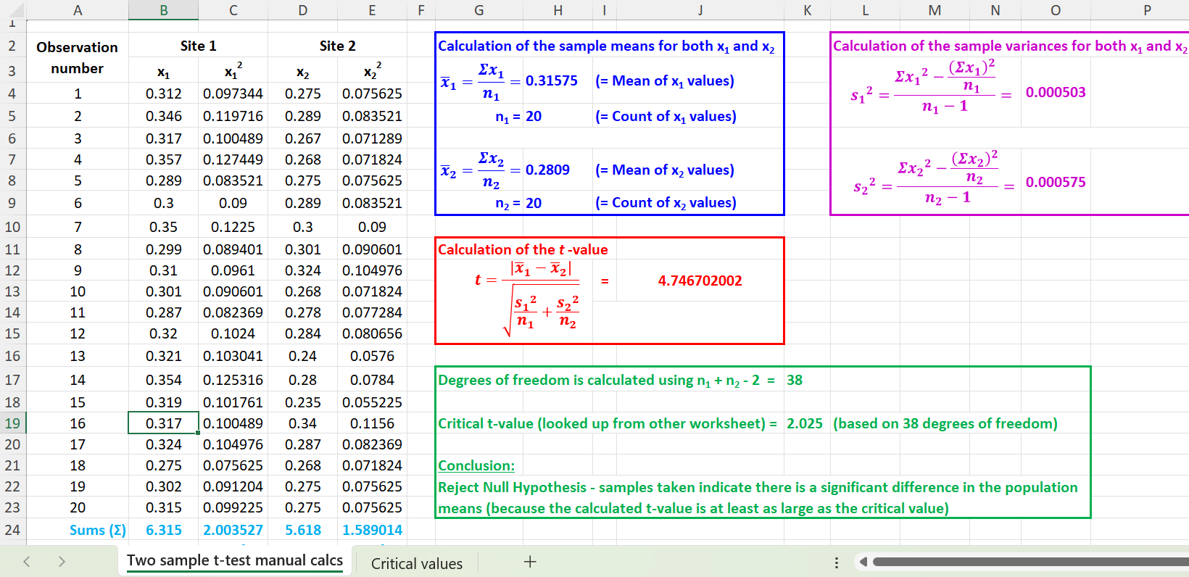
A few examples of student support work relating to Excel (6)
Statistical tests (t-test)
Notes:
Helping students with formulae in Excel

Slide 15
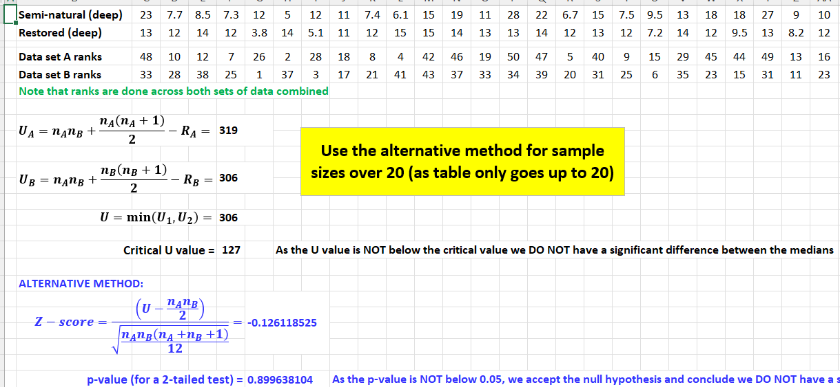
A few examples of student support work relating to Excel (7)
More statistical tests (Mann-Whitney U)
Notes:
Problems with formulae are common

Slide 16
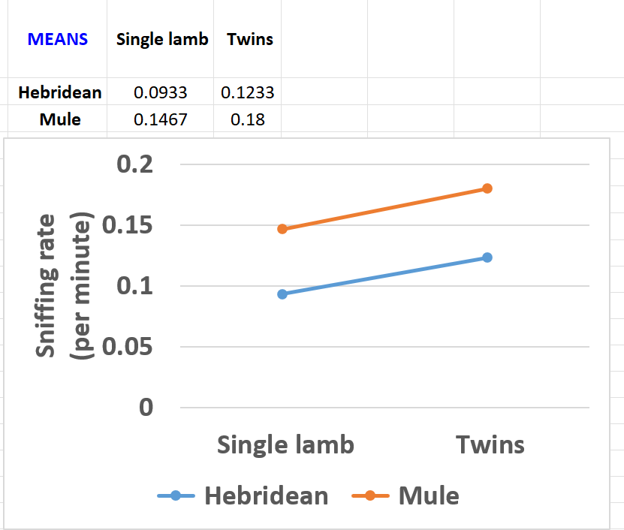
A few examples of student support work relating to Excel (8)
More graphs relating to statistical tests (2 Way ANOVA)
Notes:
Graph is used to help explain interaction (none here, as we see a similar increase in sniffing rate for both breeds when we move from having a single lamb to twins – lines are parallel or close to being parallel)

Slide 17
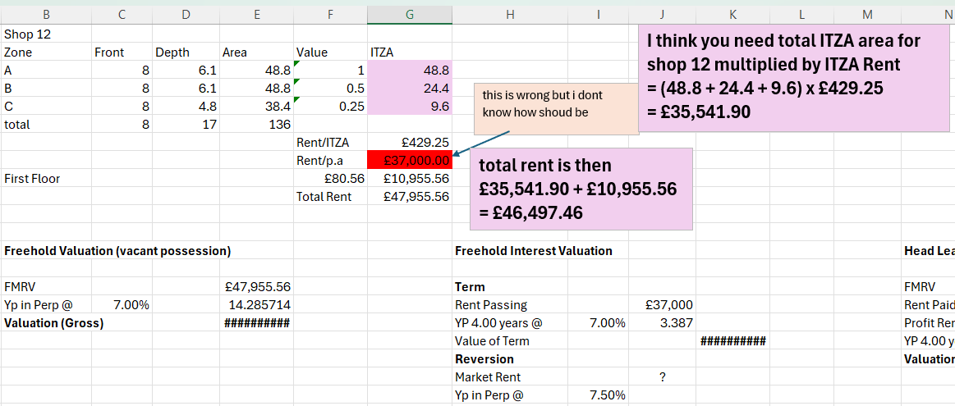
A few examples of student support work relating to Excel (9)
Valuation work (using formulae)
(Email support from me)
Notes:
There are a lot of courses doing a variety of different mathematical things (that Excel can help with)

Slide 18
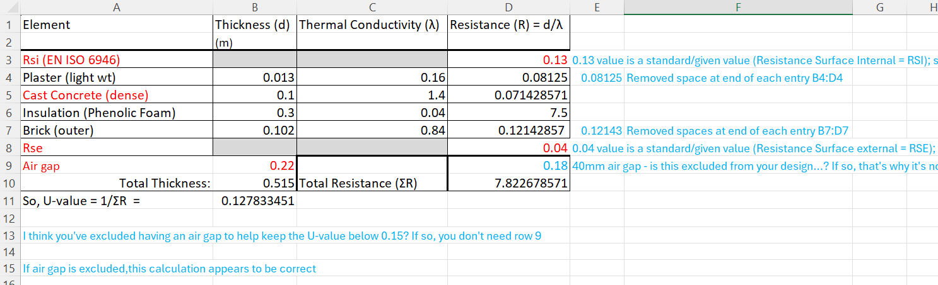
A few examples of student support work relating to Excel (10)
Calculating U-values
(More Email support – blue writing is mine)
Notes:
I told you…

Slide 19
A few examples of student support work relating to Excel (11)
Even more error bars… (Standard Error of the Mean)
Dose response ANOVA
Notes:
The means are plotted with the error bars being the SEM (Standard Error of the Mean)

Slide 20
A few examples of student support work relating to Excel (12)
Time series graph
Notes:
A student wanted to show there seemed to have been a general rise in an invasive species and a decline in another native species of fish (over time)

Slide 21
A few examples of student support work relating to Excel (13)
Histograms
Notes:
There is a video in the maths support area on producing histograms in Excel (and other commonly-used graphs)

Slide 22
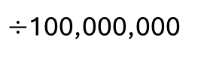
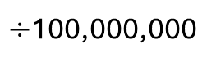
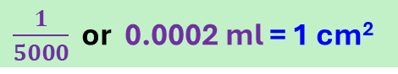
A few examples of student support work (Maths)
20 l/ha means you need 20 litres of chemical for every one hectare
20 litres = 1 hectare
1 hectare is the same area as is covered by a 100m by 100m square
Hence, 1 hectare = 100m x 100m = 10,000 m²
{As 1m = 100cm, 100m = 100 x 100cm = 10,000cm}
Students was doing a work experience (had unreliable internet)
1 hectare = 10,000cm x 10,000cm = 100,000,000 cm²
100m
1 hectare
As 20 litres is needed for 1 hectare
10,000cm
20 litres = 100,000,000 cm²
{Note: 1 litre = 1000 millilitre or 1000 ml}
100m
10,000cm
20,000 ml = 100,000,000 cm²
$÷$100,000,000
$÷$100,000,000
$\frac{1}{5000}$ or 0.0002 ml = 1 cm²
0.0002 ml of chemical is required for each 1 cm² of area to be treated
Example
Suppose you had an area of 3465cm² to treat, you’d need 3465 x 0.0002 = 0.693 ml of chemical
Notes:
Student needed remote support, so I created a tailored powerpoint (which they could then easily adapt to other situations); sometimes I create one-off videos, too

Slide 23
Any questions? 🤔 🙋‍♂️🙋‍♀️

